Slide 1
Automated Analytics For Precise
Agriculture

Slide 2
Team Members
Snekithasri.D.U
Somasunder. S

Slide 3
Objective Everybody needs a guide or a support for completing a work in a proper manner. In such a way,Every company needs analysts and senior members who will be responsible for data driven decision making. So,This issue has been solved and the analytical software is designed to support farmers in each step of farming through proper guidance.

Slide 4
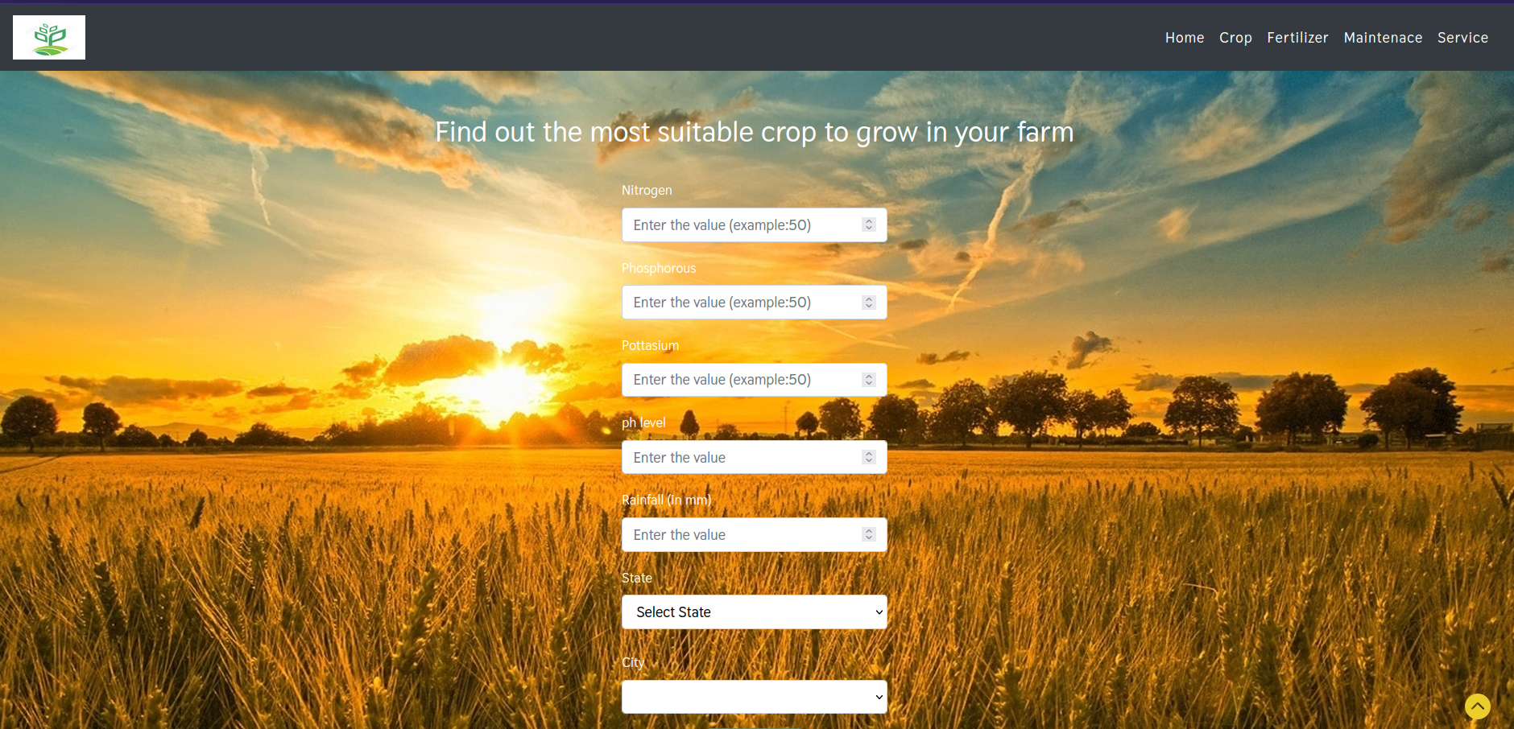
Crop Selection
What we are going to grow?

Slide 5
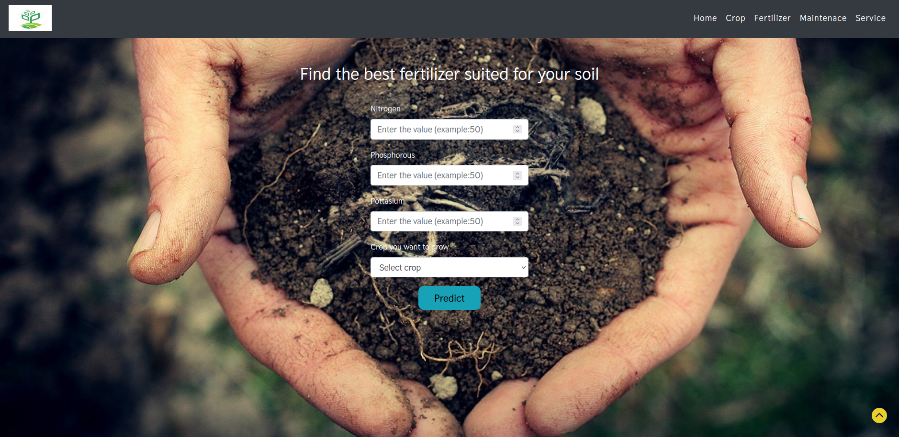
2. Fertilization and Irrigation
Availability, Timing and Amount Matters

Slide 6
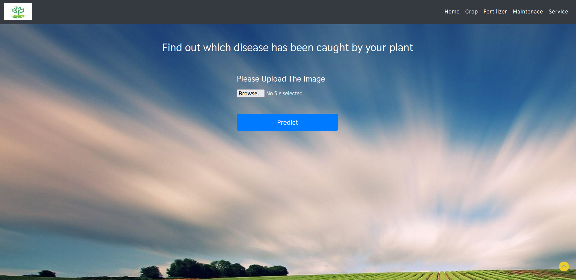
3. Maintenance
At different stages of the crop's growth – Disease, Weed and Pest removals

Slide 7
4. Service
Booking of nearest agricultural vehicle (i.e.Tractor) online at low cost
Finding best seed from online at low cost and suggesting to the farmer
Platform for Selling and Buying of Goods
YET TO BE DONE

Slide 8
FURTHER WORKS
This is just introductory prototype for our idea in this Hackathon.
What have we done?
Just Static prototype , Which is small replication of our main software. (20%-30%)
What have we yet to do ?
Making this software dynamic and accessible to farmer as mobile application, Which needs time as we are dealing with dynamic data.

Slide 9
Q & A

